Slide 1
Robots
W251 -- Dima, Ryan, Esteban, Brad

Slide 2
OpenAI Gym
https://gym.openai.com
Toolkit for developing and comparing reinforcement learning algorithms

Slide 3
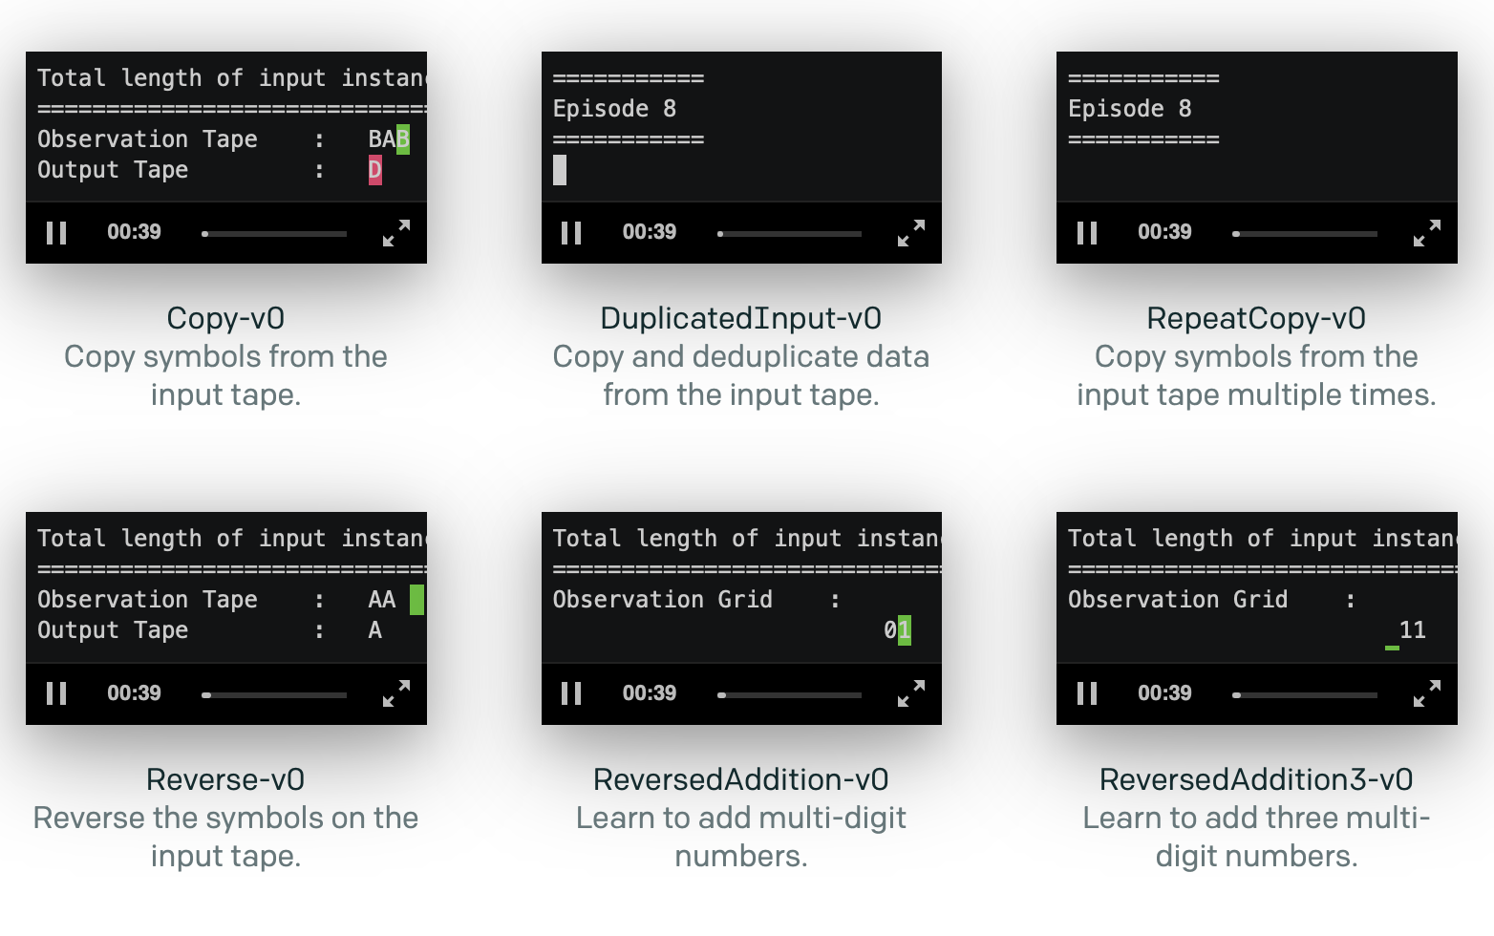
Gym Uses -- Algorithms

Slide 4
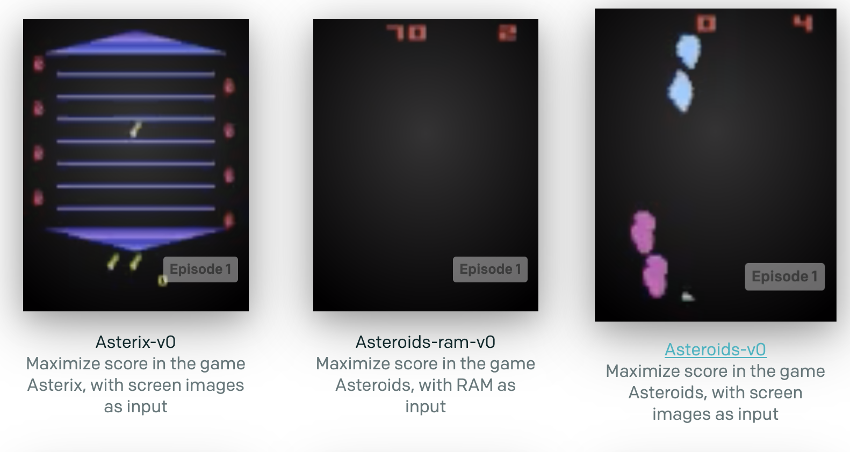
Gym Uses – Atari High Scores

Slide 5
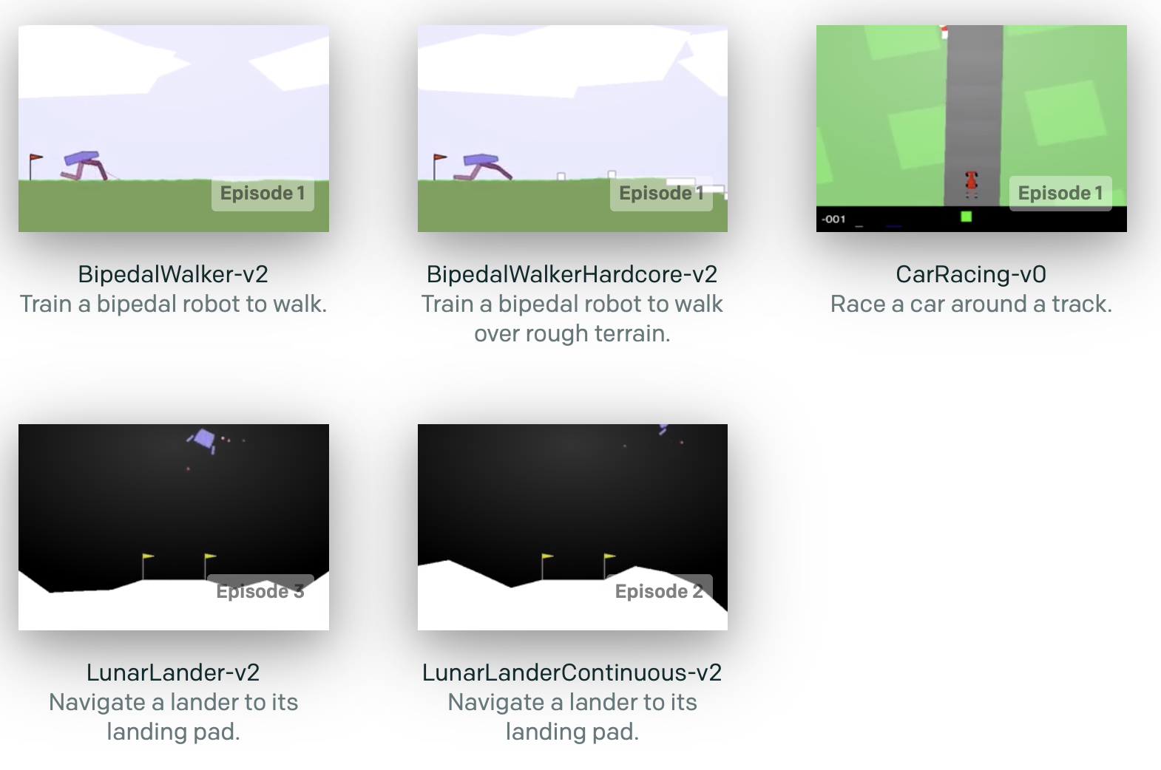
Gym Uses – Box2D

Slide 6
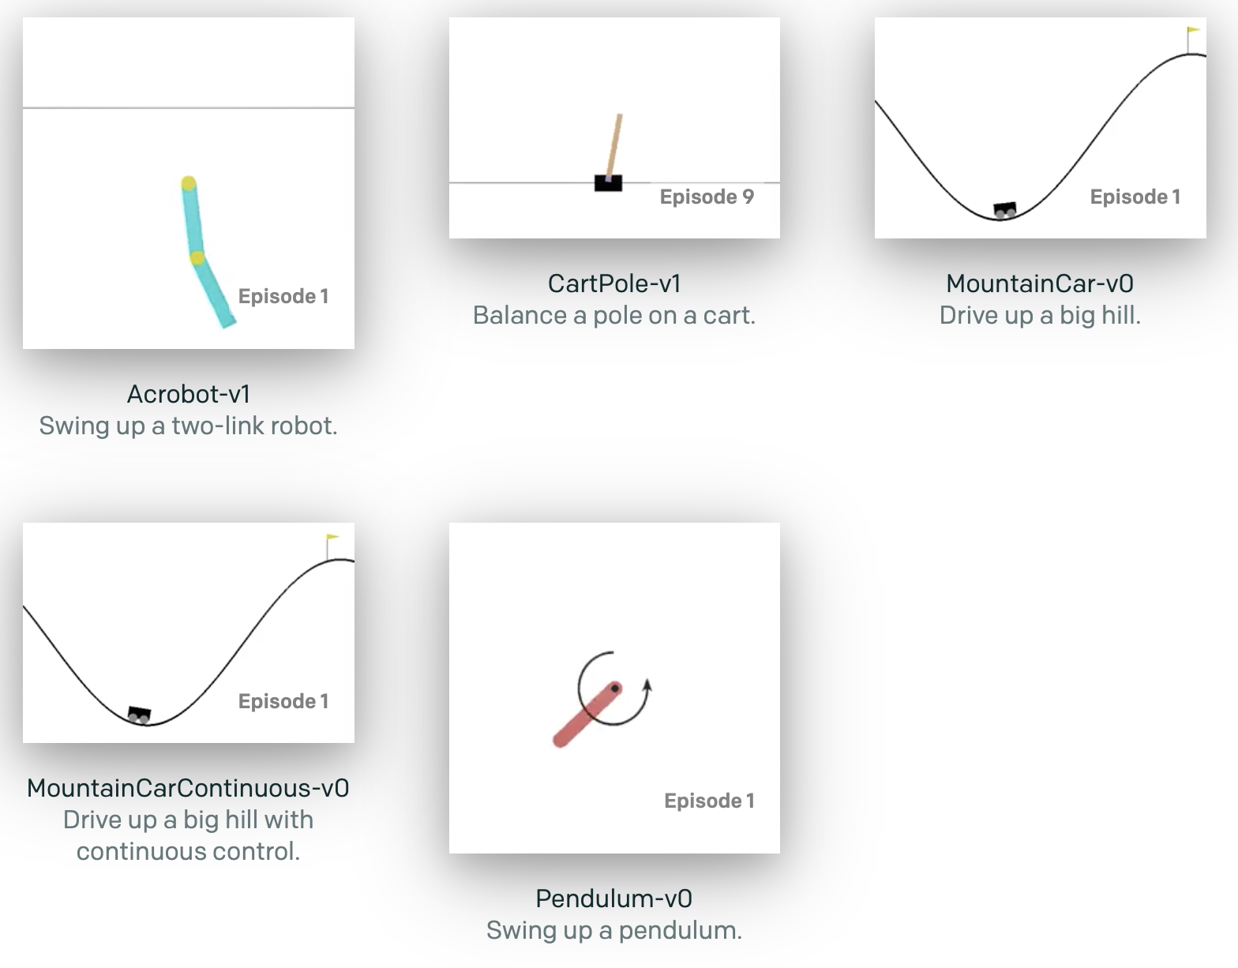
Gym Uses – Classic Control

Slide 7
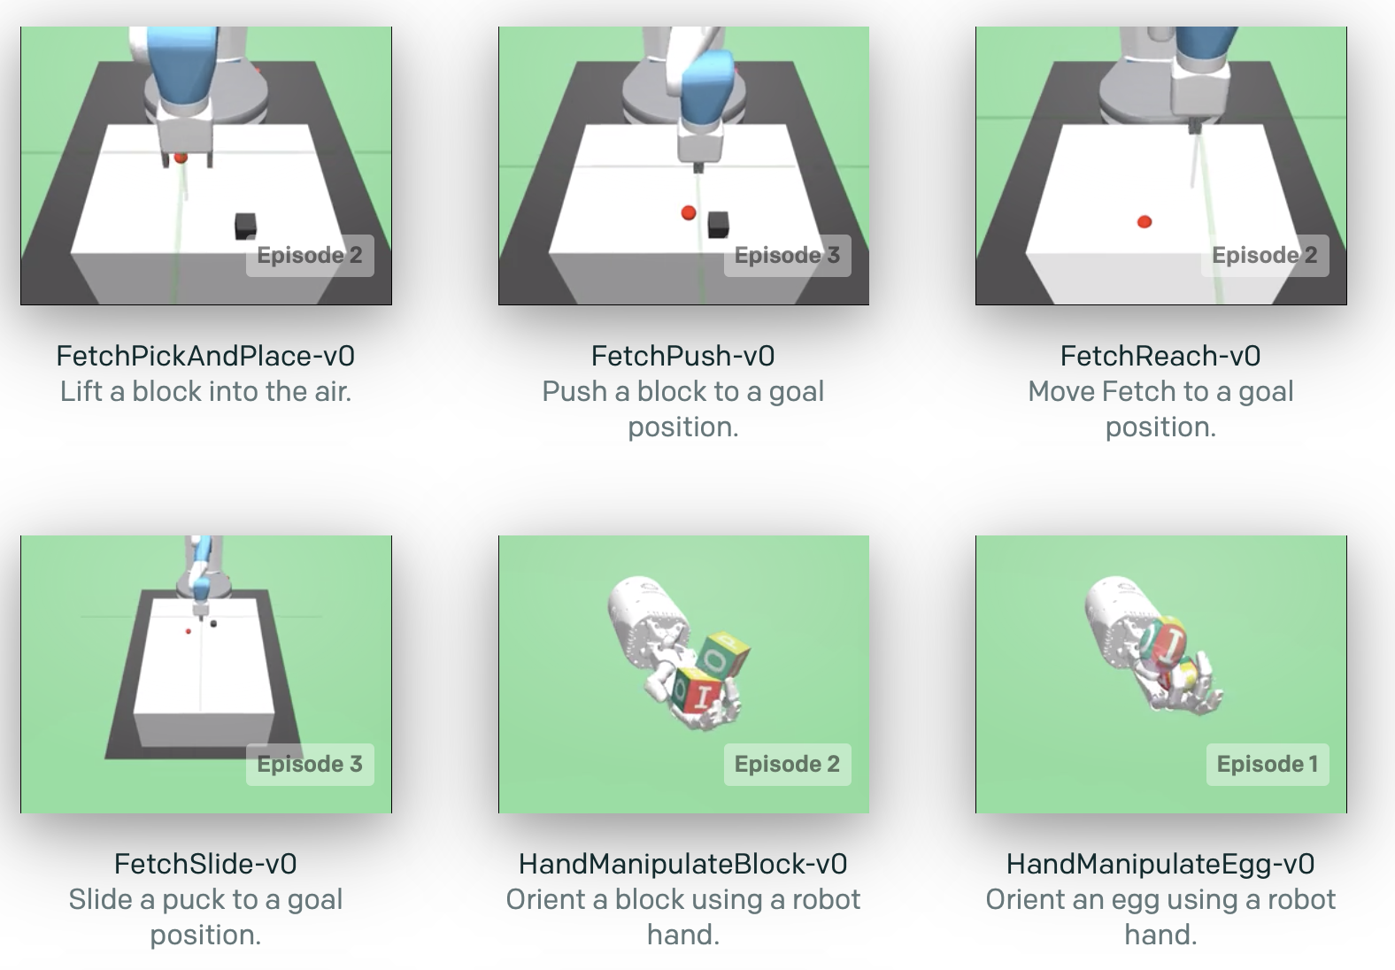
Gym Uses – Robotics

Slide 8
More Gym
Reinforcement Learning is exciting for two reasons:
It is very general, encompassing all problems that involve making a sequence of decisions: for example, controlling a robot’s motors so that it’s able to run and jump, making business decisions like pricing and inventory management, or playing video games and board games. RL can even be applied to supervised learning problems with sequential or structured outputs.
RL algorithms have started to achieve good results in many difficult environments. RL has a long history, but until recent advances in deep learning, it required lots of problem-specific engineering. DeepMind’s Atari results, BRETT from Pieter Abbeel’s group, and AlphaGo all used deep RL algorithms which did not make too many assumptions about their environment, and thus can be applied in other settings.
However, RL research is also slowed down by two factors:
The need for better benchmarks. In supervised learning, progress has been driven by large labeled datasets like ImageNet. In RL, the closest equivalent would be a large and diverse collection of environments. However, the existing open-source collections of RL environments don’t have enough variety, and they are often difficult to even set up and use.
Lack of standardization of environments used in publications. Subtle differences in the problem definition, such as the reward function or the set of actions, can drastically alter a task’s difficulty. This issue makes it difficult to reproduce published research and compare results from different papers.
Gym is an attempt to fix both problems.

Slide 9
Gazebo
http://gazebosim.org
Offers the ability to accurately and efficiently simulate populations of robots in complex indoor and outdoor environments.
Many existing patterns to re-use

Slide 10
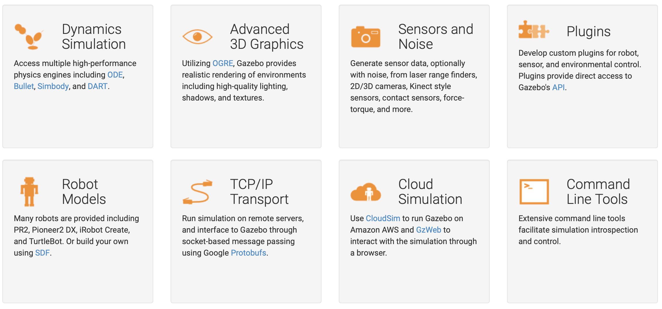
More Gazebo

Slide 11
Deep Reinforcement Learning (DRL)
Reinforcement learning refers to goal-oriented algorithms

Slide 12
DRL
Agent: An agent takes actions; for example, a drone making a delivery, or Super Mario navigating a video game. The algorithm is the agent. In life, the agent is you.
Action (A): A is the set of all possible moves the agent can make. An action is almost self-explanatory, but it should be noted that agents choose among a list of possible actions. In video games, the list might include running right or left, jumping high or low, crouching or standing still. In the stock markets, the list might include buying, selling or holding any one of an array of securities and their derivatives. When handling aerial drones, alternatives would include many different velocities and accelerations in 3D space.

Slide 13
DRL
Discount factor: The discount factor is multiplied by future rewards as discovered by the agent in order to dampen thse rewards’ effect on the agent’s choice of action. Why? It is designed to make future rewards worth less than immediate rewards; i.e. it enforces a kind of short-term hedonism in the agent. Often expressed with the lower-case Greek letter gamma: γ. If γ is .8, and there’s a reward of 10 points after 3 time steps, the present value of that reward is 0.8³ x 10. A discount factor of 1 would make future rewards worth just as much as immediate rewards. We’re fighting against delayed gratification here

Slide 14
DRL
Environment: The world through which the agent moves. The environment takes the agent’s current state and action as input, and returns as output the agent’s reward and its next state. If you are the agent, the environment could be the laws of physics and the rules of society that process your actions and determine the consequences of them.
State (S): A state is a concrete and immediate situation in which the agent finds itself; i.e. a specific place and moment, an instantaneous configuration that puts the agent in relation to other significant things such as tools, obstacles, enemies or prizes. It can the current situation returned by the environment, or any future situation. Were you ever in the wrong place at the wrong time? That’s a state.

Slide 15
DRL
Reward (R): A reward is the feedback by which we measure the success or failure of an agent’s actions. For example, in a video game, when Mario touches a coin, he wins points. From any given state, an agent sends output in the form of actions to the environment, and the environment returns the agent’s new state (which resulted from acting on the previous state) as well as rewards, if there are any. Rewards can be immediate or delayed. They effectively evaluate the agent’s action.
Policy (π): The policy is the strategy that the agent employs to determine the next action based on the current state. It maps states to actions, the actions that promise the highest reward.

Slide 16
DRL
Value (V): The expected long-term return with discount, as opposed to the short-term reward R. Vπ(s) is defined as the expected long-term return of the current state under policy π. We discount rewards, or lower their estimated value, the further into the future they occur. See discount factor. And remember Keynes: “In the long run, we are all dead.” That’s why you discount future rewards.
Q-value or action-value (Q): Q-value is similar to Value, except that it takes an extra parameter, the current action a. Qπ(s, a) refers to the long-term return of the current state s, taking action a under policy π. Q maps state-action pairs to rewards. Note the difference between Q and policy.
Trajectory: A sequence of states and actions that influence those states. From the Latin “to throw across.” The life of an agent is but a ball tossed high and arching through space-time.

